Slide 1
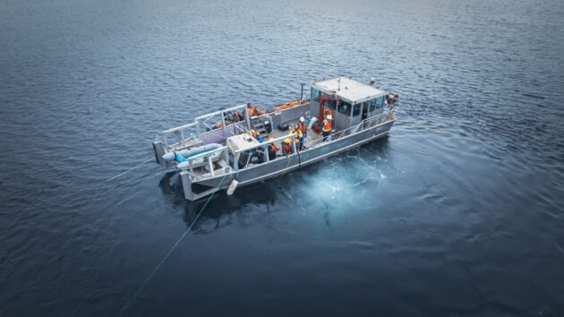
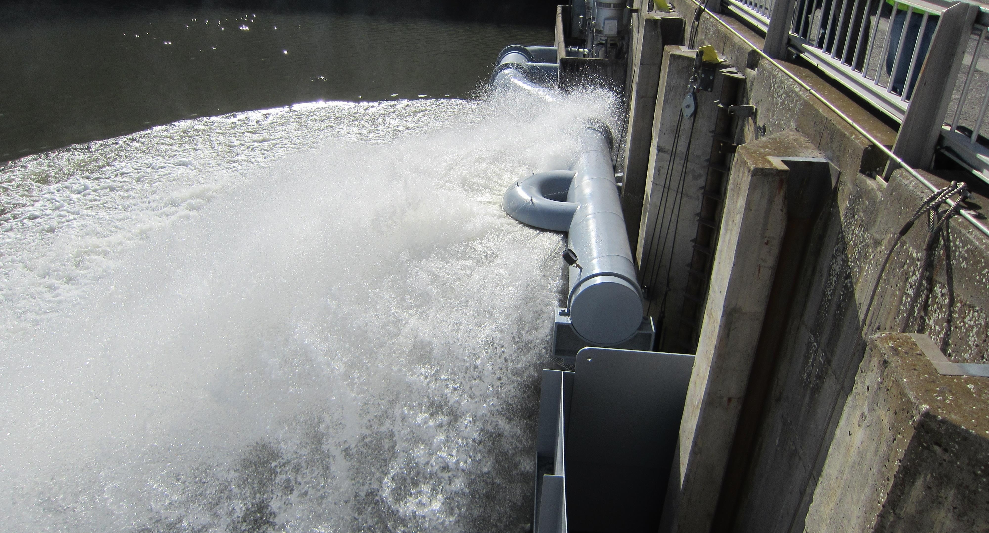
LOMO Ladder cooling
Project Update
Prototyping
CFD Modeling

Slide 2
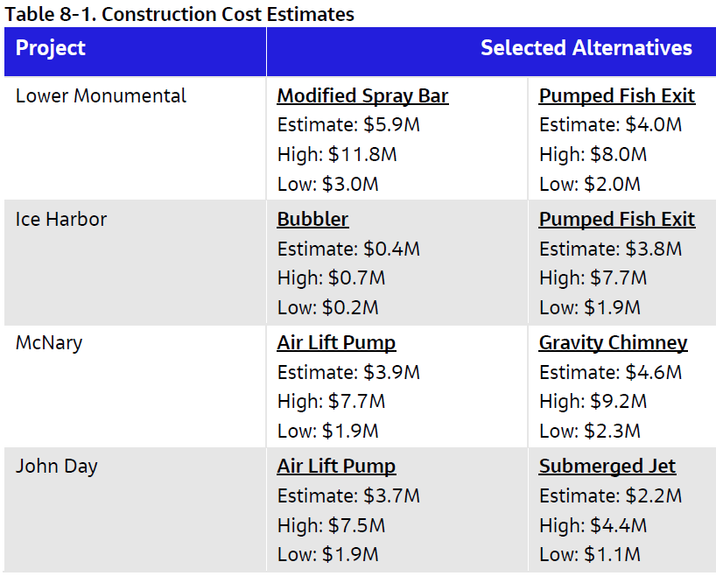
Overview
Continuing with DDR development
Will develop scope of work with FFDRWG for key alternatives.
Intent is to develop and award contract for A/E 100% design while prototype testing on going.
Lower Monumental – Modified Spray Bar or Pumped Fish Exit
McNary - Air Lift Pump or Gravity Chimney w/ Pumped Fish Exit

Slide 3
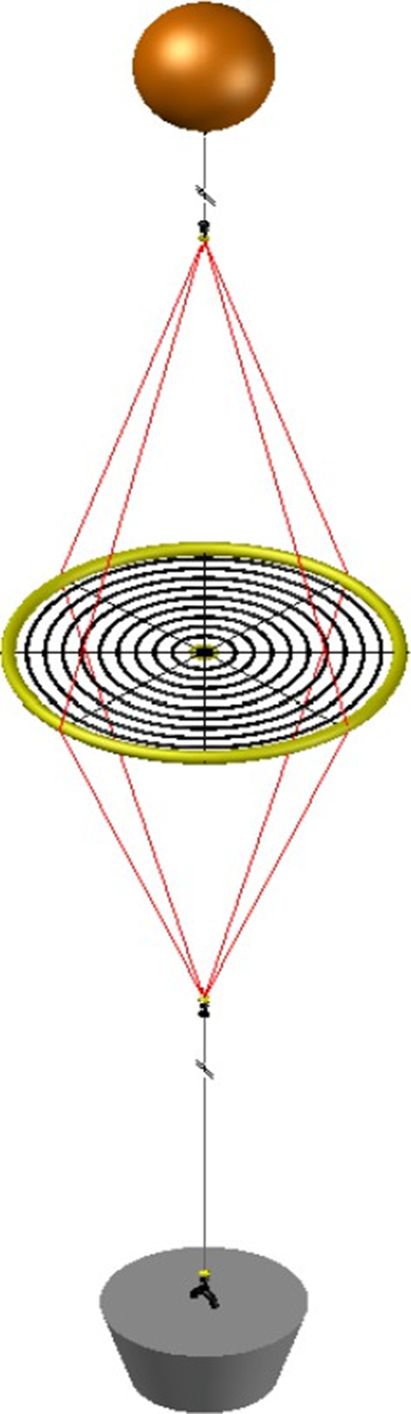
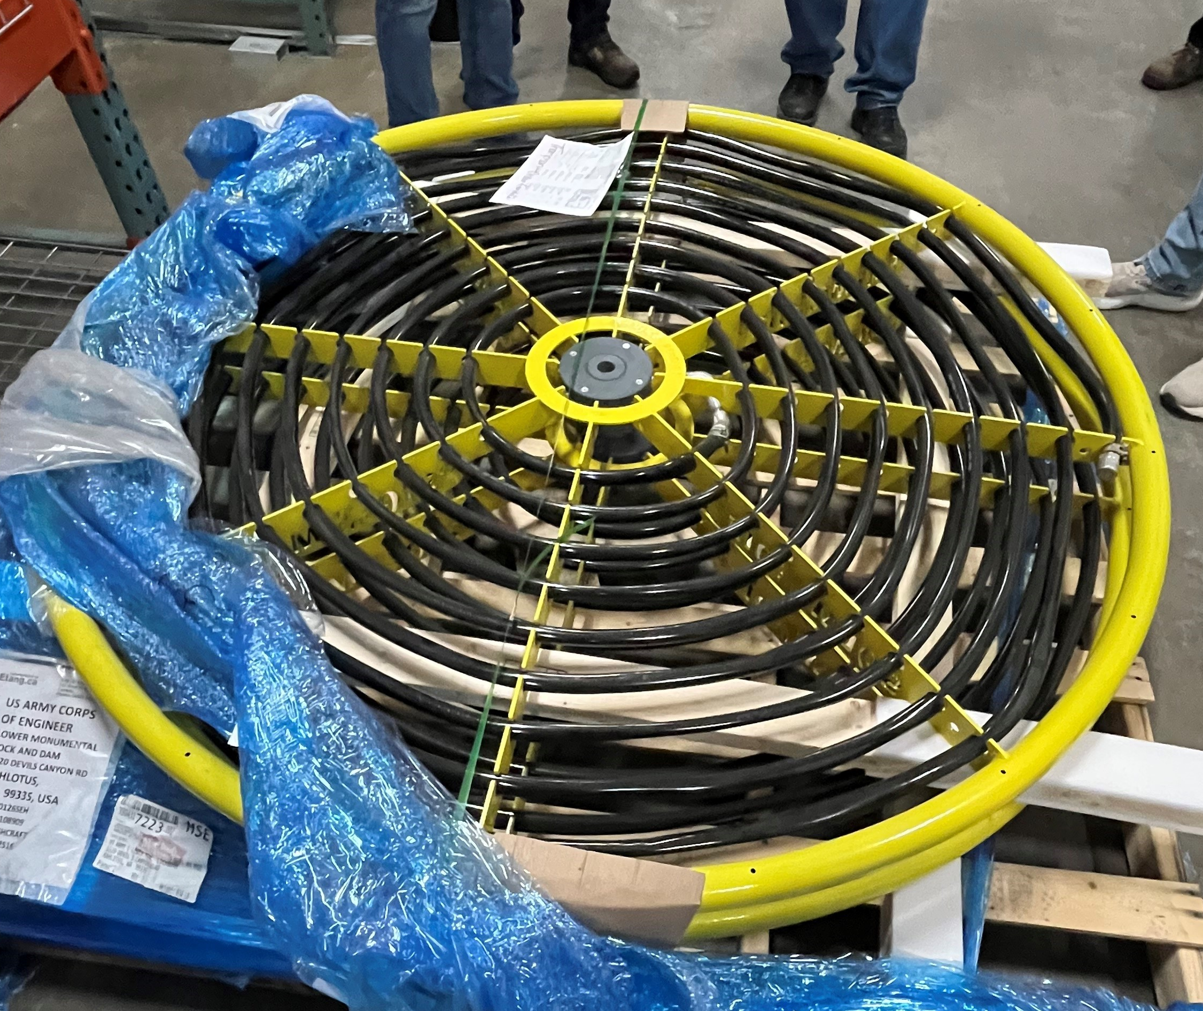
The Bubbler
Still planning to implement first bubbler near north ladder and test before the end of February 2026.
Plan to deploy second bubbler near south fish ladder exit and diffuser on the first bubbler’s testing day.
We will be onsite for tests following deployment and will measure velocities using an ADCP (acoustic doppler current profiler) system.
Invites to come for the deployment of the second bubbler and testing of the first once a date is decided on.

Slide 4
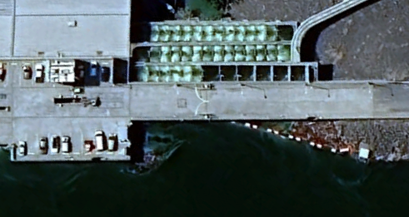
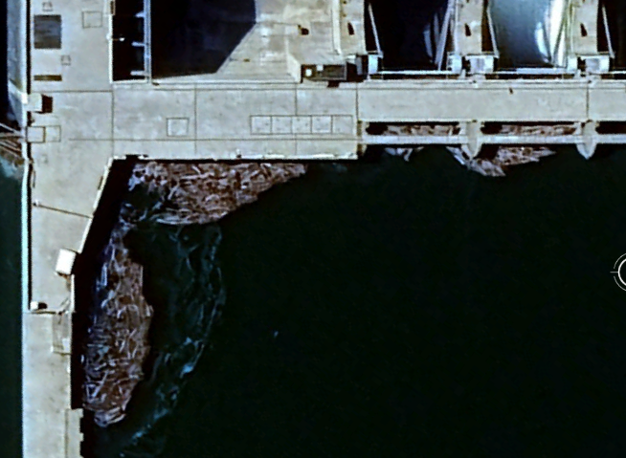
Prototyping Cont’d
Project is excited for the debris management aspect of the bubbler in addition to the cooling effects.
Temperature strings and TDG sensors will be implemented near each bubbler at both projects to determine bubbler effectiveness, monitor ladder deltas and ensure air is not getting into the diffuser intakes or ladders.
Bubbler for Oregon Shore ladder at McNary also.
Lower Monumental modeling and monitoring will be primary investigation site. McNary currently anticipated to be ladder temp only observation, but looking for feedback.
N Diffuser Intake
N Ladder Exit
1st Bubbler Location
Debris
S Ladder Exit
S Diffuser Intake
Debris
2nd Bubbler Location*
* Approximate location, has not been decided

Slide 5
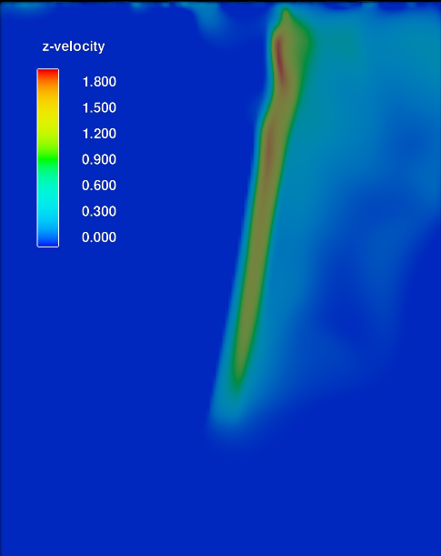
CFD Evaluation
Using the computational fluid dynamics (CFD) software, Flow-3D Hydro to model the bubbler to estimate upwell flow rates, thermal deltas and ladder exit temperatures.
Worked with FlowScience to calibrate our models to two known field studies. Using default settings, these models produced great results.
Model shows upwelling rates near 200 cfs.
Added stratified temperature layers mimicking a typical July-August Lomo forebay, model shows good mixing and surface plume, still developing model.
Note - Simulations above have same scale, different units. Top picture is our model using Flow-3D Hydro, bottom is from ASME study using STAR-CCM+.

Slide 6
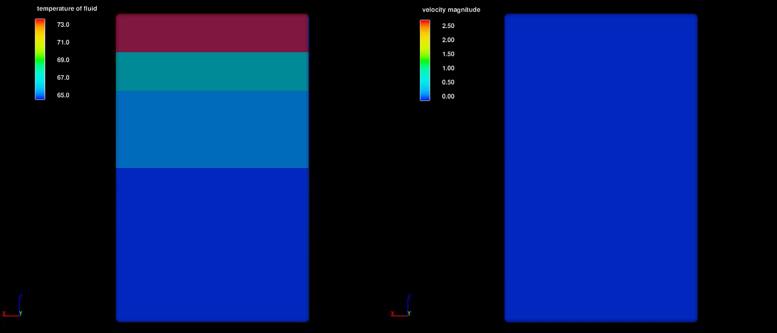
Bubbler plume (4.5-minute real time)

Slide 7
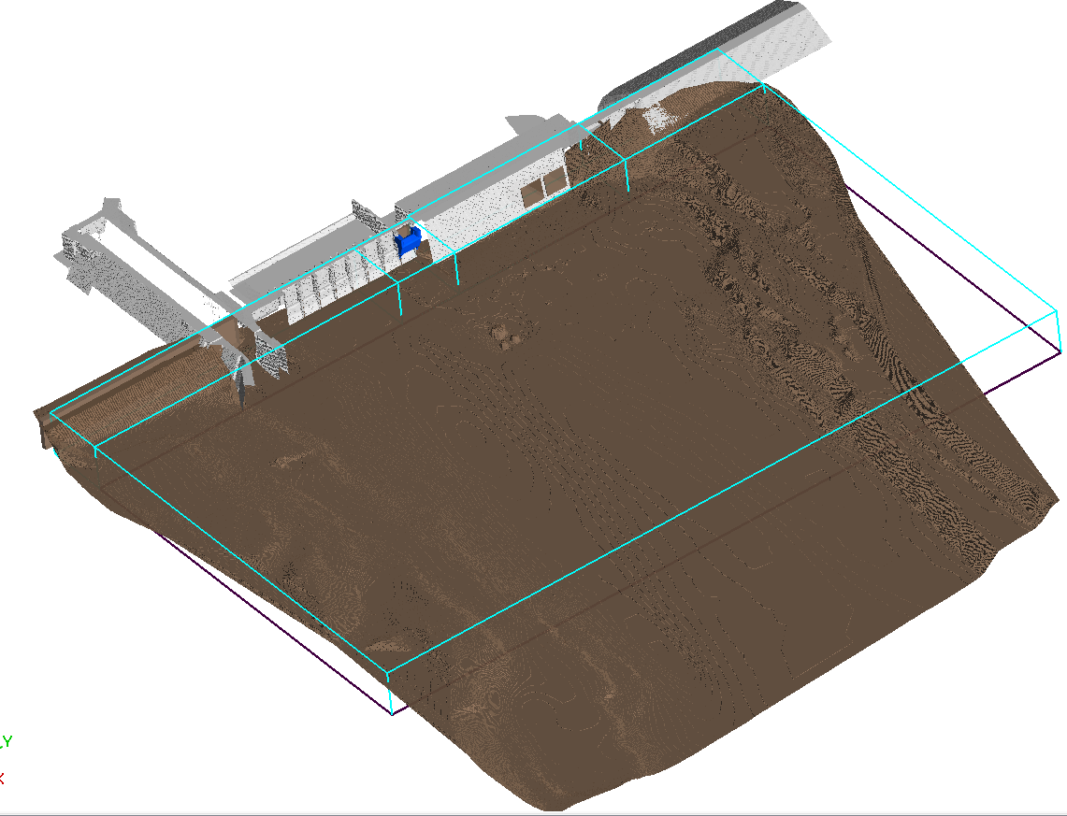
CFD Evaluation Cont’d
1st Bubbler Location
Modeling Lomo forebay conditions with stratified temperature layers with typical July – August conditions (~35kcfs)
Will have a large-scale model with flow patterns and temperatures throughout the entire forebay.
Will use these results as boundary conditions for the final bubbler model.
2nd Bubbler Location
Flow

Slide 8
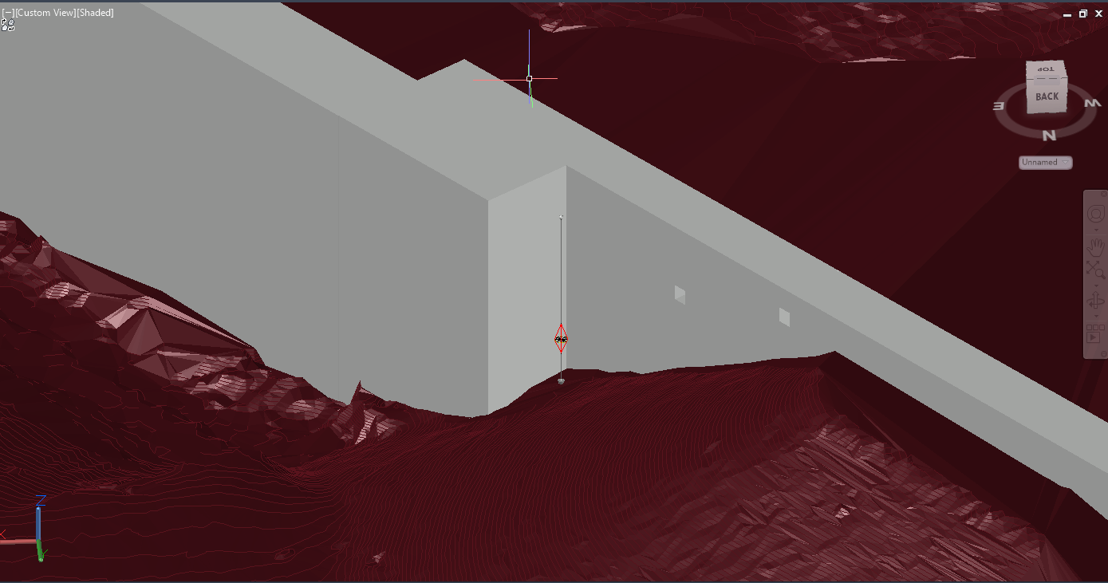
Diffuser 1 Placement
N Diffuser Intake
N Diffuser Intake
Bubbler System
Bubbler System
N Ladder Exit
Turbine Intake Not shown
N Ladder Exit
Flow

